Slide 1

MUSIC STORE Data Analyst Portfolio Project

Slide 2





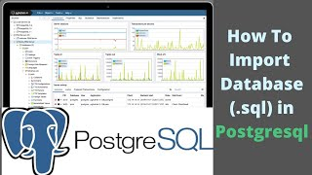


POSTGRESQL SERVER
System Engineering
Creating Reports
Changes - 2022
Writing Search Queries
© 2019 Copyright dunnhumby / All rights reserved

Slide 3


Slide 4


POWER BI TO POSTGRESSQL CONNECTION

Slide 5

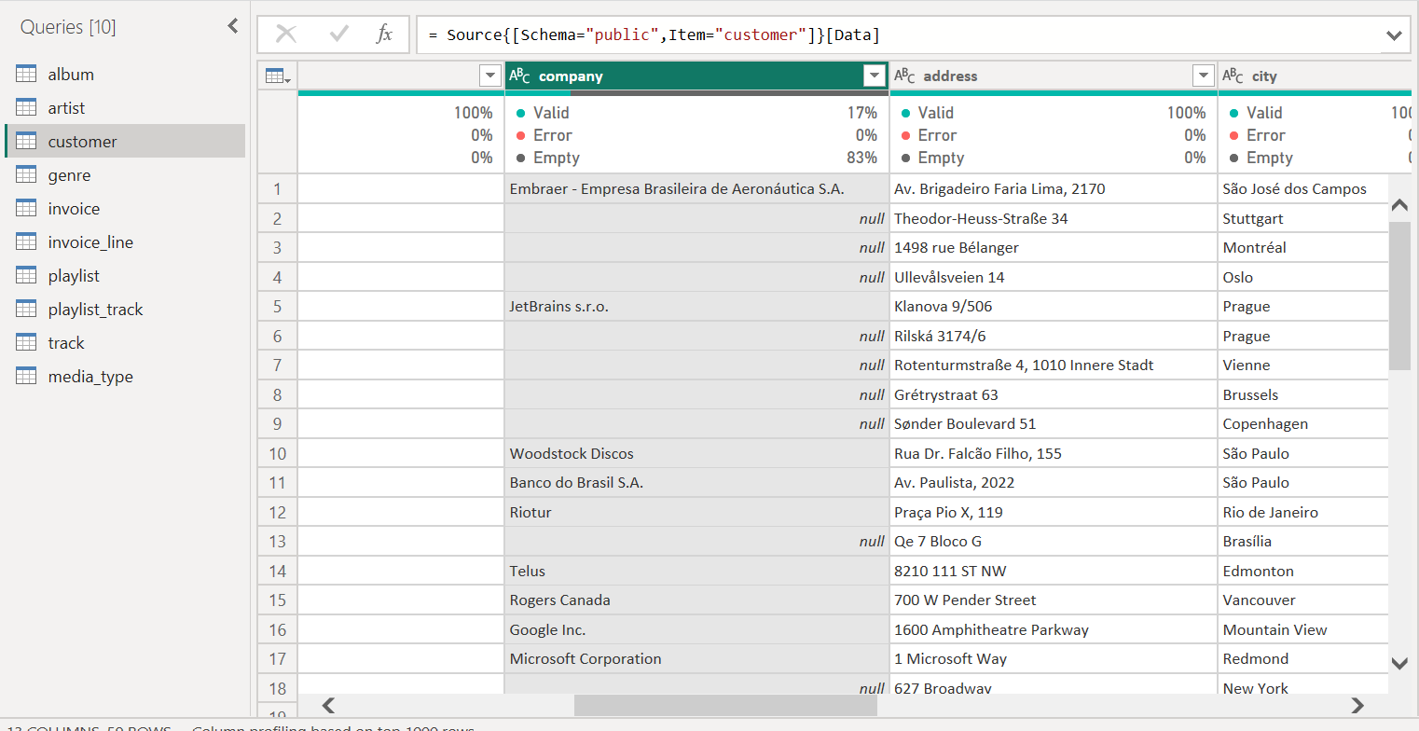
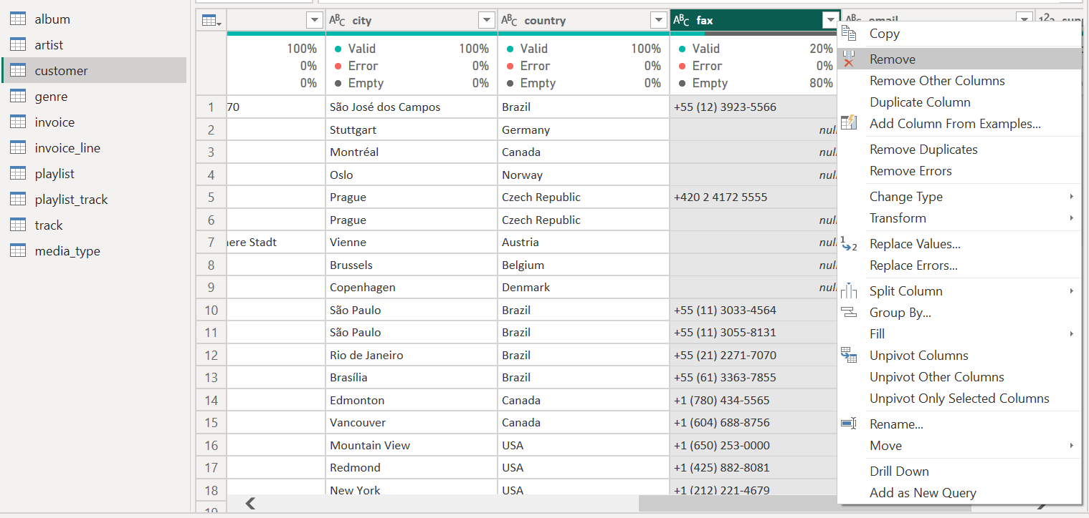
DATA CLEANING

Slide 6

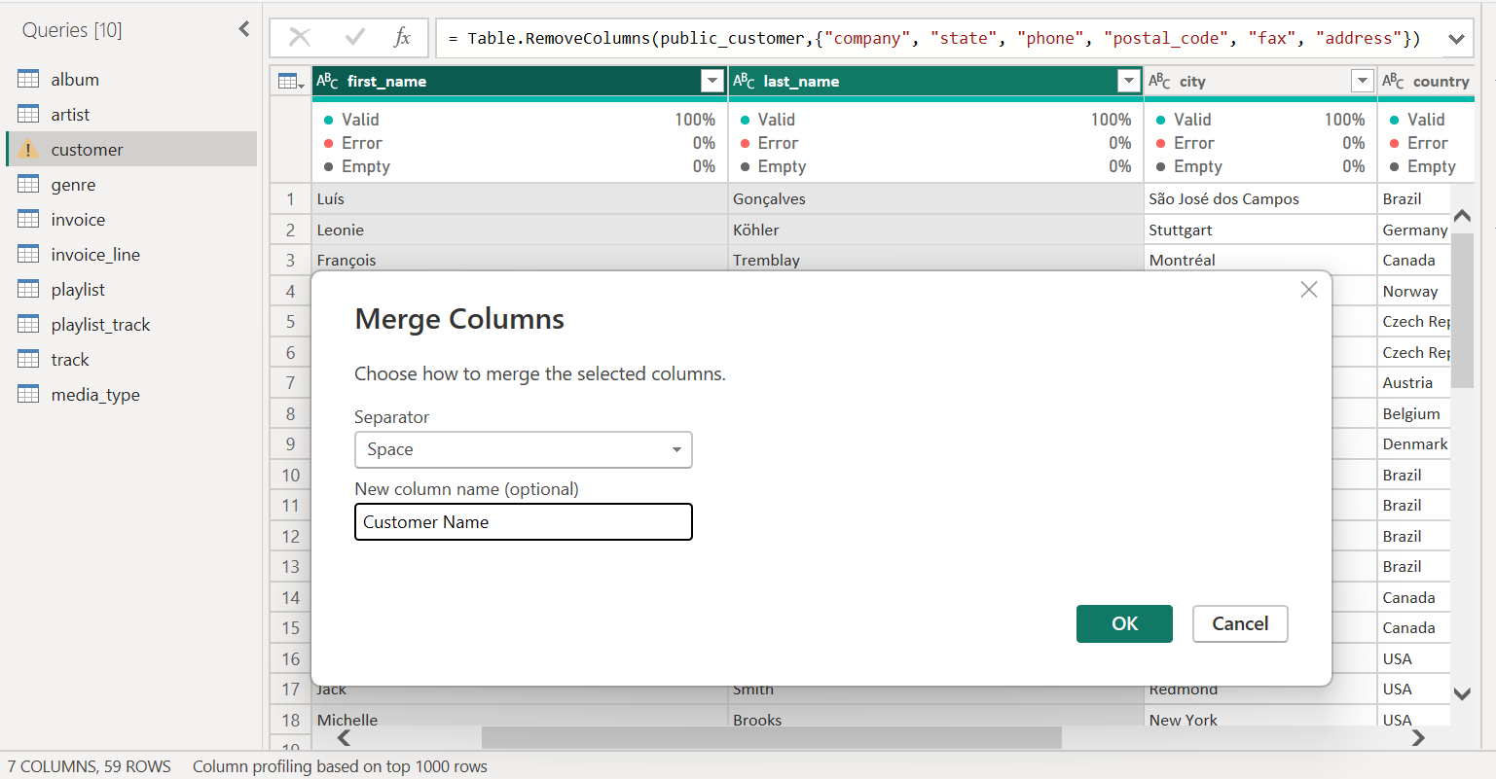
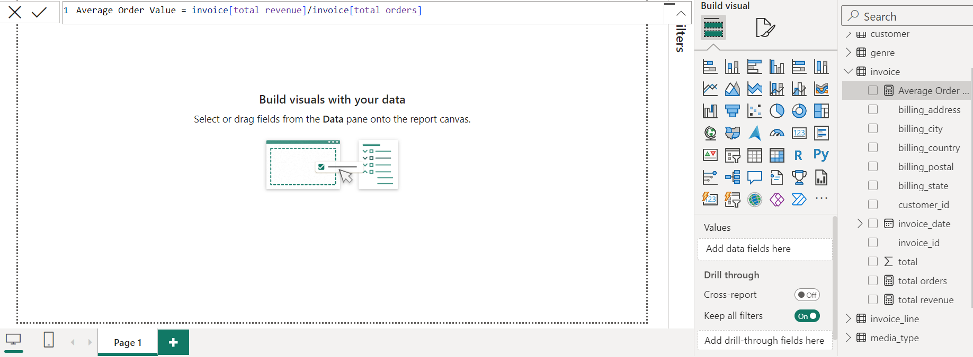
DATA PROCESSING

Slide 7
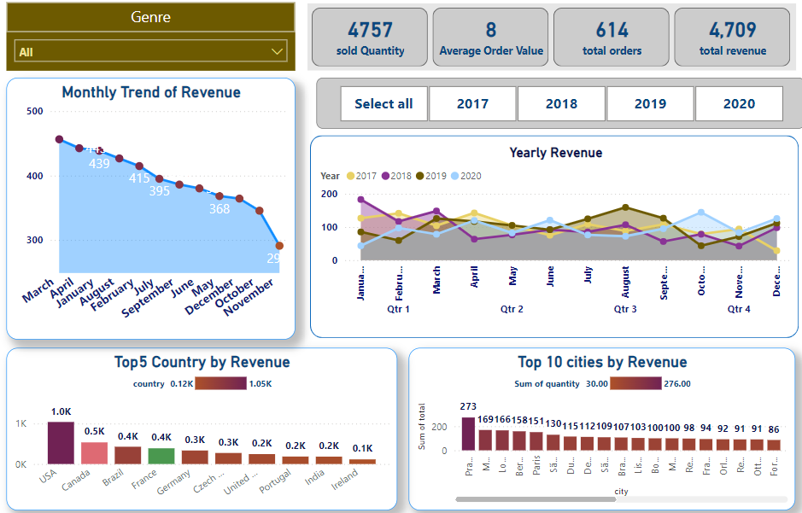
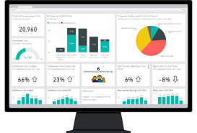
DATA VISUALIZATION

Slide 8
KPI’s Requirement
We need to Analayze the Key Indicator for music store sales data to gain insight into business performance . Specially want to calculate the following metrics
Total Revenue
Average Order Value
Total Music sold
Total Sales
Total Orders
Highest Revenue contributor Country and City
Highest Track sold and contributor for the same
PROBLEM STATEMENT

Slide 9
Charts REQUIREMENTS
Would like to visualize the various aspects of music sales to gain insight and understand the key trends . We have to identify the following requirements for creating Charts
Monthly/Yearly Trend : create an Area chart to display the Monthly and yearly trend of total Revenue over a specific period of time . It will help us to identify the pattern and fluctuation in revenue.
Top 10 Revenue contributor county and city: create a Clustered column chart to show the distribution of sales across top10 region , it will provide insight into the popularity in the country and city and their contribution to overall sales.
PROBLEM STATEMENT

Slide 10
Selling pattern for Region : use map to show the sale across different region.
Track wise revenue and sell: use slicer to select the genre and check for the revenue generation from the particular genre.
Top 5 and Bottom 5 City / Country with track sold: Use stacked column charts to show the quantity of track sold in top 5 and bottom 5 country and city.
Top 5 best selling track : user pie Chart to show the Top5 track been sold.
Total quantity and sales and revenue : Use Cards to show total revenue and quantity sold with order numbers year wise , Region wise
PROBLEM STATEMENT

Slide 11
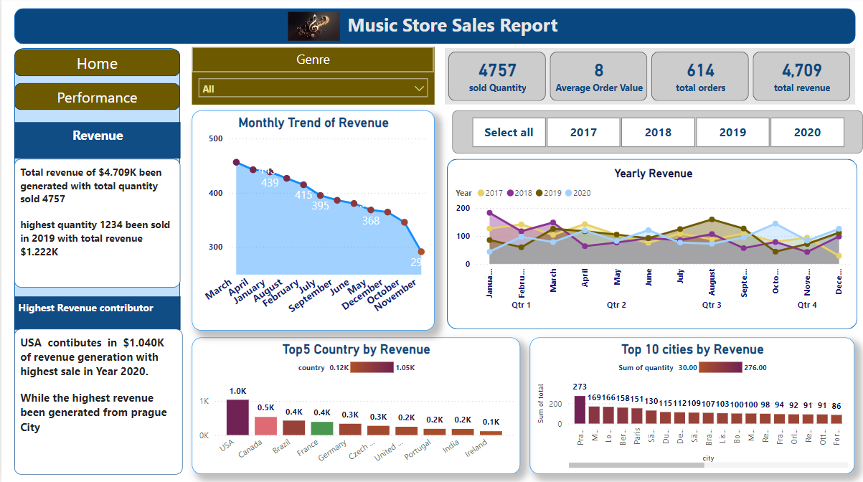

Slide 12
